Slide 1
Descriptive Statistics

Slide 2
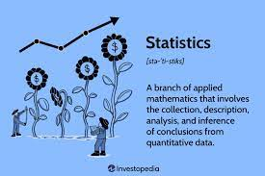
Statistics
Statistics is a branch of mathematics that deals with the collection, analysis, interpretation, and presentation of data. Data scientists use statistics to understand the patterns and trends in data, to test hypotheses and draw conclusions, and to communicate their findings and recommendations. Some of the statistical methods that data scientists use are:
Notes:
Source:https://www.datasciencedegreeprograms.net/faq/how-do-data-scientists-use-statistics/

Slide 3
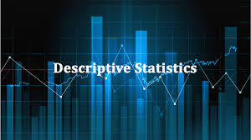
Descriptive statistics
Descriptive statistics: These are methods to summarize and display data using graphs, tables, and numerical measures. For example, data scientists can use descriptive statistics to calculate the mean, median, mode, standard deviation, and range of a data set.
Notes:
Source:https://www.datasciencedegreeprograms.net/faq/how-do-data-scientists-use-statistics/

Slide 4
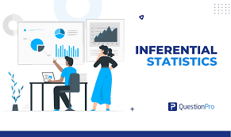
Inferential statistics
Inferential statistics: These are methods to make generalizations or predictions about a population based on a sample of data. For example, data scientists can use inferential statistics to estimate the proportion of customers who are satisfied with a product, or to test whether a new treatment is effective compared to one already exists
Notes:
Source:https://www.datasciencedegreeprograms.net/faq/how-do-data-scientists-use-statistics/

Slide 5
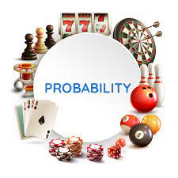
Probability
Probability: This is the study of how likely an event or outcome is to occur. Probability is the foundation of inferential statistics, as it allows data scientists to measure the uncertainty and variability in data. For example, data scientists can use probability to calculate the confidence intervals and p-values for their estimates and tests.
Notes:
Source:https://d138zd1ktt9iqe.cloudfront.net/media/seo_landing_files/amar-terms-in-probability-01-1608711675.png

Slide 6
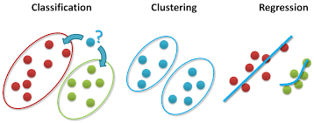
Regression
Regression: This is a method to model the relationship between one or more explanatory variables and a response variable. Regression can be used for prediction, explanation, or optimization purposes. For example, data scientists can use regression to predict the sales of a product based on its price, features, and advertising budget.
Notes:
https://www.datasciencedegreeprograms.net/faq/how-do-data-scientists-use-statistics/

Slide 7
Classification
Classification: This is a method to assign labels or categories to data points based on their features or characteristics. Classification can be used for identification, diagnosis, or recommendation purposes. For example, data scientists can use classification to identify spam emails based on their content, subject line, and sender.

Slide 8
Clustering
Clustering: This is a method to group data points based on their similarity or dissimilarity. Clustering can be used for exploration, segmentation, or anomaly detection purposes.

Slide 9
Clustering
For example, data scientists can use clustering to explore customer preferences based on their purchase history, demographics, and behavior.
In short It is the science of collecting, organizing, summarizing, and analyzing data to get meaningful insight from it to draw an optimal conclusion.

Slide 10
Use cases of Stats
Data analysis and visualization: Data scientists and data engineers use statistics to explore, summarize, and present data using graphs, tables, and numerical measures. They also use statistics to test hypotheses, compare groups, and identify relationships among variables.
Data modeling and prediction: Data scientists and data engineers use statistics to build and evaluate predictive models using regression, classification, clustering, and other techniques. They also use statistics to measure the accuracy, precision, and reliability of their models and predictions.
Notes:
Source:https://hevodata.com/learn/role-of-data-analytics-in-engineering/

Slide 11
Use cases of Stats
Data quality and integrity: Data scientists and data engineers use statistics to assess the quality and validity of the data they collect, process, and store. They also use statistics to detect and correct errors, outliers, missing values, and anomalies in the data.
Data optimization and experimentation: Data scientists and data engineers use statistics to optimize business processes, products, and services using techniques such as A/B testing, multivariate testing, and optimization algorithms. They also use statistics to design and conduct experiments to measure the impact of changes and interventions.
Notes:
Source:https://hevodata.com/learn/role-of-data-analytics-in-engineering/

Slide 12
Sectors in which Statistics is used
Statistics can be applied in many sectors as medicine, information technology, engineering, finance, marketing, accounting, business etc. If specifically, we focus on finance or fintech it can be used for:
Data analysis, preparing budgets, financial forecasting, monitoring a company, decision making, stock price prediction, risk management etc.
Technologies used -Python, R, AI and ML

Slide 13
Sectors in which Statistics is used
Bankers use statistical approaches based on probability to estimate the number of deposits and their claims for a certain day.
Machine learning is an interdisciplinary field that uses statistics, probability, algorithms to learn from data and provide insights which can be used to build intelligent applications.
AI deals with making predictions and finding patterns in structures of data to make those predictions.

Slide 14
Real world scenario of data modeling and prediction for sales
Company XYZ is an online retailer that sells various products to customers across the world. The company wants to increase its sales and revenue by understanding the factors that influence customer behavior and demand.
Data scientists and data engineers at company XYZ collect and process data from various sources, such as website logs, customer reviews, product catalogs, social media, and external market data. They use statistics to clean, transform, and analyze the data to identify patterns and trends.

Slide 15
Real world scenario of data modeling and prediction for sales
Data scientists and data engineers at company XYZ use statistics to build and evaluate predictive models using regression, classification, clustering, and other techniques. For example, they use regression to predict the sales of each product based on its features, price, availability, and seasonality. They use classification to segment customers into different groups based on their demographics, preferences, and purchase history. They use clustering to find similar products that can be recommended to customers based on their browsing and buying behavior.

Slide 16
Real world scenario of data modeling and prediction for sales
Data scientists and data engineers at company XYZ use statistics to measure the accuracy, precision, and reliability of their models and predictions. They also use statistics to test the assumptions and limitations of their models and to compare different models and methods. They use techniques such as cross-validation, confusion matrix, ROC curve, and R-squared to evaluate their models.

Slide 17
Real world scenario of data modeling and prediction for sales
Data scientists and data engineers at company XYZ use their models and predictions to provide insights and recommendations to the business stakeholders. They use data visualization tools to present their findings and communicate their results. They also use their models and predictions to optimize business processes, products, and services. For example, they use their models to adjust the prices of products based on demand and competition. They use their predictions to forecast the inventory and supply chain needs. They use their recommendations to personalize the customer experience and increase customer loyalty.

Slide 18
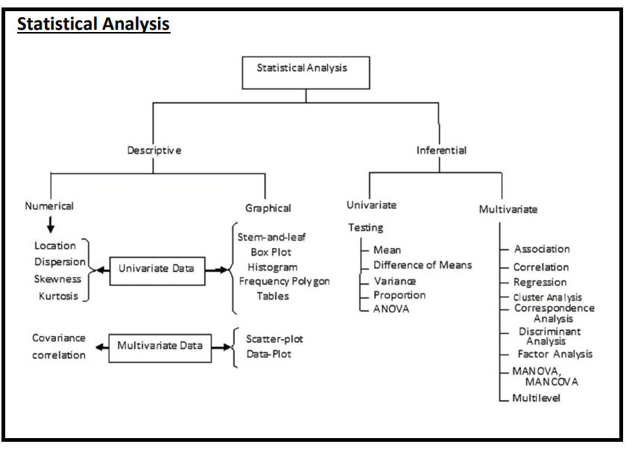
Let us understand the flow!

Slide 19
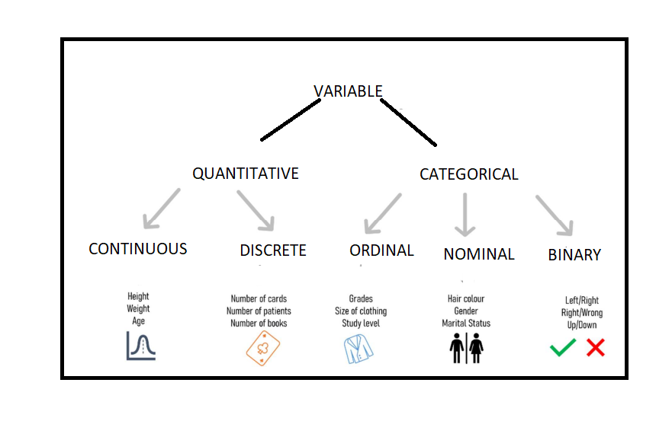
Variable and its types
Variables & Its type: A variable is defined as the alphabetic character that expresses a numerical value or a number. In algebraic equations, a variable is used to represent unknown quantity or quality of data.
Notes:
Source:https://www.scribbr.com/statistics/descriptive-statistics/

Slide 20
Qualitative v/s Quantitative variables
To divide the variables as qualitative and quantitative variables, we need to identify whether the variable can be expressed as a number or a category. If the variable can be expressed as a number, it is a quantitative variable. If the variable can be expressed as a category, it is a qualitative variable.
Year
Country
Status
Life expectancy
Adult Mortality
Hepatitis B
BMI
Total expenditure
GDP
Population
Income composition of resources

Slide 21
Qualitative v/s Quantitative variables
The qualitative variables are:
Country: This is a nominal variable that indicates the name of the country.
Status: This is a nominal variable that indicates whether the country is developing or developed.
Hepatitis B: This is a nominal variable that indicates whether the country has Hepatitis B vaccination coverage.
Polio: This is a nominal variable that indicates whether the country has Polio vaccination coverage.
Diphtheria: This is a nominal variable that indicates whether the country has Diphtheria vaccination coverage.
Notes:
Source:

Slide 22
Qualitative v/s Quantitative variables
The quantitative variables are:
Year: This is an interval variable that indicates the year of observation.
Life expectancy: This is a ratio variable that indicates the average number of years a person can expect to live at birth.
Adult Mortality: This is a ratio variable that indicates the probability of dying between 15 and 60 years per 1000 population.
Infant deaths: This is a ratio variable that indicates the number of infant deaths per 1000 live births.
Percentage expenditure: This is a ratio variable that indicates the general government expenditure on health as a percentage of total government expenditure.

Slide 23
Descriptive Statistics
Descriptive statistics is the process of summarizing and displaying data using numerical measures and graphs. It helps to understand the characteristics and distribution of the data, as well as to identify any outliers or errors.
A possible case scenario of using descriptive statistics is:
You are a researcher who wants to study the relationship between age and creativity among a group of students. You design a survey that asks the students to report their age and to complete a creativity test that measures their divergent thinking skills.
You have a dataset that contains information about each student, such as student ID, age, and creativity score. The creativity score ranges from 0 to 100, with higher scores indicating higher creativity.
Notes:
Source:

Slide 24
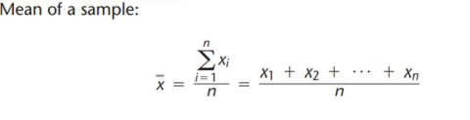
The measure of central Tendency
Mean (Mean is affected by outlier) :
●Average of data point (sum of data point/ number of data points)
● Affected by outlier

Slide 25
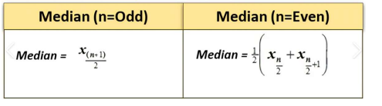
The measure of central Tendency
Median :
This can be defined as Middle positional Value of given data set and can be derived in two steps
First by Arranging dataset (n) in ascending order then
For odd numbers of observations, by selecting the observation at (n+1)/2 positions for an odd number of observation
For an even number of observation, calculating the average of two data points at nth/2 term and (n+1)/2 term

Slide 26
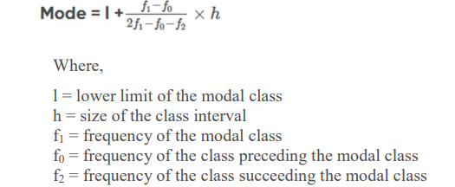
The measure of central Tendency
Mode:
Mode is one of the values that indicate a central tendency of a set of data. Mode or modal value gives us an idea about which of the items in a data set is more likely to occur frequently. It is the measure of Central Tendency other than Mean and Median.
Depending on the type of dataset given, you can find one, two three or even multiple modal values. Some data sets may have no mode value at all.
● Most occurring value in the data set
● Can be unimodal, bimodal, multimodal

Slide 27
Measures of variability
Measures of variability, also known as measures of dispersion, provide information about the spread or dispersion of a dataset. They quantify the extent to which data points deviate from the central tendency (mean, median, etc.).
Range:
Definition: The range is the simplest measure of variability and represents the difference between the maximum and minimum values in a dataset.
Range = Maximum Value - Minimum Value

Slide 28
Measures of variability
Variance:
Definition: Variance measures the average squared deviation of each data point from the mean. It provides a measure of how spread out the data points are around the mean.
Variance = (Sum of (Data Point - Mean)^2) / (Number of Data Points)
Standard Deviation:
Definition: Standard deviation is the square root of the variance. It represents the average amount by which data points deviate from the mean.
Standard Deviation = sqrt(Variance)

Slide 29
Measures of variability
The interquartile range (IQR) and quartiles are measures of variability that divide a dataset into four equal parts.
Quartiles: Quartiles divide a dataset into four equal parts, representing the boundaries of three quarters of the data. The three quartiles are commonly denoted as Q1, Q2, and Q3.
Q1 (First Quartile): It is the median of the lower half of the dataset. It separates the lowest 25% of the data from the rest.
Q1 = (n + 1) / 4th observation
Q2 (Second Quartile): It is the median of the entire dataset. It represents the middle value that divides the data into two equal parts (50% below and 50% above).
Q2 = (n + 1) / 2nd observation (same as the median)
Q3 (Third Quartile): It is the median of the upper half of the dataset. It separates the highest 25% of the data from the rest.
Q3 = 3 * (n + 1) / 4th observation

Slide 30
Measures of variability
Interquartile Range (IQR): The interquartile range (IQR) is the range of values between the first quartile (Q1) and the third quartile (Q3). It represents the spread of the central half of the dataset. The formula to calculate the IQR is:
IQR = Q3 - Q1
The IQR is a robust measure of variability as it is not affected by extreme values or outliers.

Slide 31
Skewness and Kurtosis
Skewness and kurtosis are statistical measures that provide information about the shape and distribution of a dataset.
Skewness: Skewness measures the asymmetry of a dataset, indicating whether the data is skewed to the left or right of the mean.
Positive Skewness: If the tail of the distribution is longer on the right side, the data is positively skewed. This means that the majority of the data points are concentrated on the left side of the distribution, and the right tail is stretched out.
Negative Skewness: If the tail of the distribution is longer on the left side, the data is negatively skewed. This means that the majority of the data points are concentrated on the right side of the distribution, and the left tail is stretched out.

Slide 32
Skewness and Kurtosis
Zero Skewness: If the distribution is symmetric, the skewness is zero, indicating an equal balance of data points on both sides of the mean.
Skewness = (1/n) * Σ((x - mean) / standard deviation)^3

Slide 33
Skewness and Kurtosis
Kurtosis measures the peakedness or flatness of a distribution compared to the normal distribution.
Leptokurtic Kurtosis: If the distribution has high kurtosis, it means it has a sharper peak and heavier tails compared to the normal distribution. This indicates a higher concentration of data around the mean and more extreme outliers.
Mesokurtic Kurtosis: If the distribution has kurtosis equal to zero, it means it has a similar shape to the normal distribution.
Platykurtic Kurtosis: If the distribution has low kurtosis, it means it has a flatter peak and lighter tails compared to the normal distribution. This indicates a more dispersed data with fewer outliers.
Kurtosis = (1/n) * Σ((x - mean) / standard deviation)^4

Slide 34



